Slide 1
Rearranging Speed Equation and teach examples

Slide 2
Learning Objectives
I can mathematically rearrange the speed equation.
I can calculate speed using the formula.
Notes:
In this lesson, students will learn the definitions of both potential and kinetic energy. They will also be able to give examples of each and explain how potential energy changes into kinetic energy.

Slide 3
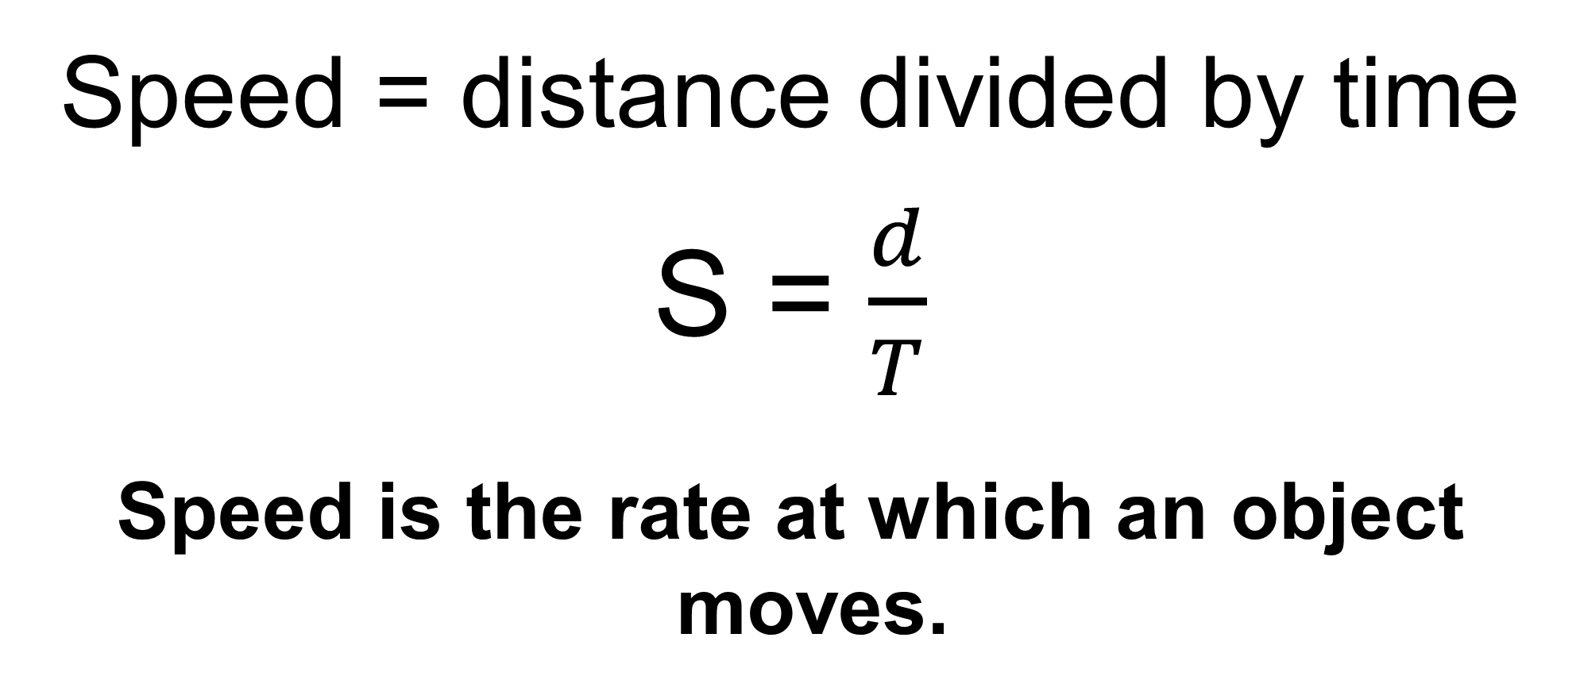
Calculating Speed
Speed = distance divided by time
S = $\frac{d}{T}$
Speed is the rate at which an object moves.
meters
Meters/second
seconds

Slide 4
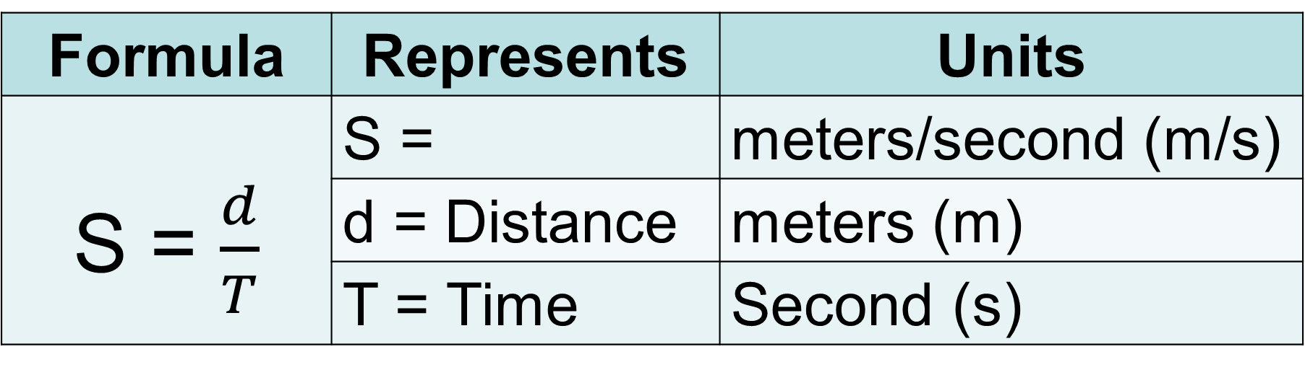
Formula Representation
Formula | Represents | Units
S = $\frac{d}{T}$ | S = | meters/second (m/s)
 | d = Distance | meters (m)
 | T = Time | Second (s)
Speed

Slide 5
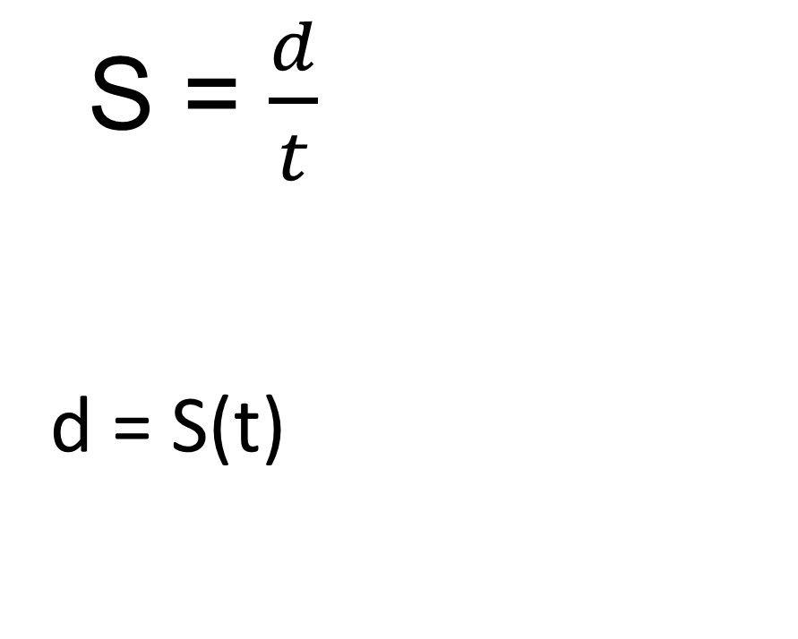
Solve for Distance (d)
S = $\frac{d}{t}$
d = S(t)
Step 1 – Multiply both sides by t - time
(t)
(t)

Slide 6



Solve for Time (t)
S = $\frac{d}{t}$
Step 1 – Multiply both sides by t – time
Step 2 – Divide by S - speed on both sides.
(t)
(t)
d = St
__
S
__
S
t = $\frac{d}{S}$

Slide 7
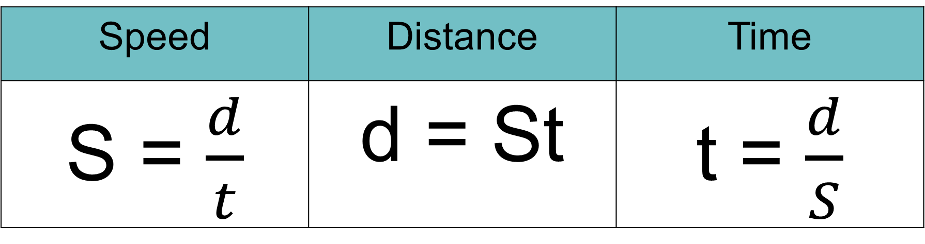
Speed Related Equations
Speed | Distance | Time
S = $\frac{d}{t}$ | d = St | t = $\frac{d}{S}$

Slide 8



Calculation Example #1
1. What is the speed of a walker if he traveled 10m in 5s?
Given/ Unknown | Work
S = d = t=
?
10m
$$S=\frac{d}{t}$$
$$S= \frac{10m}{5s}$$
$$S=2 m/s$$
5s

Slide 9



Calculation Example #2
2. It took 3.5 hrs for a train to travel the distance between two cities at a speed of 120 miles/hr. How many miles lie between the two cities?
Given/ Unknown | Work
S = d = t=
120mi/hr
?
$$\text{d}\text{ = }\text{St}$$
$$\text{d}\text{ = (120}\text{mi}\text{/}\text{hr}\text{)}\text{(3.5}\text{hrs}\text{)}$$
$$\text{d}\text{ = 420 }\text{miles}$$
3.5hrs

Slide 10



Calculation Example #3
3. A car is traveling at a rate of 75km/hr. How long will it take the driver to travel 225km?
Given/ Unknown | Work
S= D = t =
75km/hr
225km
$$t=\frac{d}{S}$$
$$t= \frac{225km}{75km/hr}$$
$$t=3 hrs$$
?

Slide 11



Calculation Example #4
4. John took 45 min to bicycle to his grandmother’s house, a total of 4 km. What was his speed in km/hr?
Given/ Unknown | Work
S = d= t =
?
1st convert the time into hours by dividing 45min by 60min.
60min=1hr
4km
45min
or .75hr
$$S=\frac{d}{t}$$
$$S= \frac{4km}{.75hr}$$
$$S=5.3 km/hr$$

